Slide 1

Comprehensive Disaster and Climate Risk Management
Strengthening synergies between DRR and CCA
approaches, data, plans, and tools
8 July 2021

Slide 2
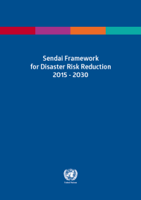
Sendai Framework for Disaster Risk Reduction 2015-2030
Goal
Intended Outcome
Calls for strong political leadership, commitment, and involvement of all stakeholders at all levels from local to national and international to pursue a goal to prevent new and reduce existing disaster risk through the implementation of integrated and inclusive economic, structural, legal, social, health, cultural, educational, environmental, technological, political and institutional measures that prevent and reduce hazard exposure and vulnerability to disaster, increase preparedness for response and recovery, and thus strengthen resilience.
The substantial reduction of disaster risk and losses in lives, livelihoods and health and in the economic, physical, social, cultural and environmental assets of persons, businesses, communities and countries.
Notes:
Adopted at the Third UN World Conference on Disaster Risk Reduction on March 18, 2015
Endorsed by the UN General Assembly on May 15, 2015.
15-year, voluntary, non-binding agreement
4 Priorities for Action and 7 Global Targets
Recognizes that the State has the primary role to reduce disaster risk but that responsibilities are to be shared with other stakeholders including local government and the private sector.
Shift from disaster loss to disaster risk
Shift from disaster management to disaster risk management
Shift from “what to do?” to “how to do?”
Focus on people-centred preventive approach to DRR
Primary responsibility of States for DRR
Shared responsibility for DRR with stakeholders
Scope includes slow-onset, man-made and bio hazards
Set of global targets
Set of guiding principles

Slide 3
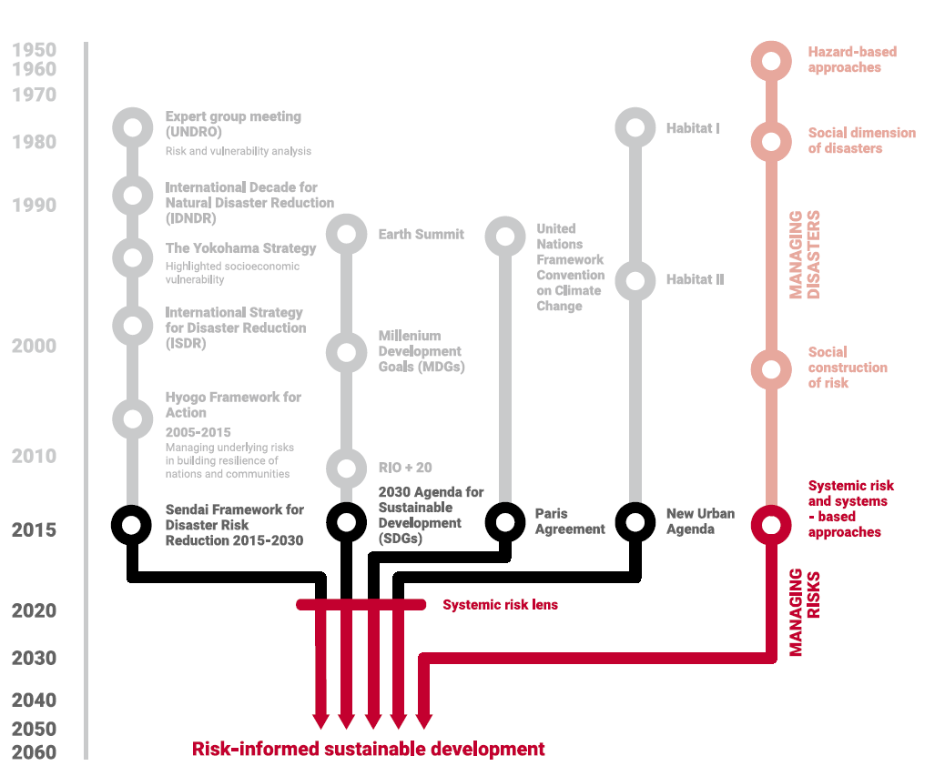
Risk reduction – a journey through time and space
The Global Assessment Report on Disaster Risk Reduction (GAR), 2019
Notes:
25 years of international agreements on disaster risk reduction
3 coherent international agreements in 2015: Sendai Framework for Disaster Risk Reduction, the Sustainable Development Goals (SDGs) and the Climate Agreement.
HFA Monitor and Global Assessment Report only since 2007
Is the approach to disaster risk management following since 1990 ‘fit for purpose’ to reduce disaster risk and facilitate sustainable development?
HFA provided 5 priorities for action, including to ‘reduce the underlying risk factors’
Asian example:
Development gains lost can be much attributed to rapid economic growth and private and public investments in hazardous areas such as tsunami- and cyclone-prone coasts, flood-exposed river basins and earthquake-prone cities.
This has generated new risk and led to a steady rise in disaster losses with a significant economic, social, health, cultural and environmental impact across Asia.
For instance, the socio-economic impact of the 2011 floods in Thailand, the 2011 earthquake/tsunami/nuclear disaster in Japan, and 2013 typhoon Haiyan in the Philippines are still being felt today in the daily lives of hundreds of thousands of people.
Disasters continue to undermine efforts to achieve sustainable development.

Slide 4






Comprehensive Disaster and Climate Risk Management
Risk
Analysis
Risk Financing
Synergies
Past and Future Data
Risk Planning
Risk Governance
Notes:
Synergies
Disaster Risk Reduction + Climate Change Adaptation + Development + Humanitarian
Past and Future Data
Scientific projections & trends;
Weather & climate
Disaster Loss Database
Reporting & Monitoring
Risk Analysis
Hazards – extreme and slow onset events, climate- and non-climate-related hazards;
Socio-economic factors;
Systemic, cascading, compounding risks;
Risk layering
Risk Planning
DRR Strategies, National Adaptation Plans; Nature-based Solutions, Development Plans; National and Sub-national, Sectoral
Risk Financing
Across scales (pre-emptive, anticipatory, post)
Sustainable, Predictable, Scalable
Integrated into Planning Instruments
Timely!
Risk Governance
Whole of society – all ages, different sectors/specializations

Slide 5
State of disaster loss: Sendai Targets A & B
Target A: No. of countries reporting
2018: 78
2019: 69
2020: 44
Target B: No. of countries reporting
2018: 84
2019: 67
2020: 45
Notes:
Disaster mortality and people affected are among the key outcomes that can serve to measure the effectiveness of national and local DRR strategies at reducing the impact of disasters.
In 2020, a total of 95 thousand deaths and missing persons were recorded by 44 countries, compared to just over 25 thousand in 2019 and 41 thousand in 2018 by 69 and 78 countries, respectively.
This is in line with an overall trend of declining mortality since 2005 (also confirmed by the EM-DAT CRED database).
COVID-19 is however is reversing this progress, as it overwhelms health systems and highlights underlying socio-economic vulnerabilities to biological hazards.
The overwhelming majority of people affected by disasters – either injured, ill or with disrupted livelihoods – have been recorded in Africa and Asia and the Pacific.

Slide 6
State of disaster loss: Sendai Target C
Target C: No. of countries reporting
2016: 75
2017: 78
2018: 71
2019: 53
2020: 35
Notes:
Economic loss from disasters, as recorded under Target C, has remained more or less stable, according to most recent reporting
Economic loss attributed to disasters averages at around 70 Billion USD dollars per year, with over two thirds accrued in the Americas and Caribbean region
Due to the computational nature of this indicator, data becomes available with a time-gap of one year, meaning that reporting for 2020 has been largely incomplete (35 countries as of March 2021) and expected to improve ahead of the October 2021 milestone
A typical breakdown of economic loss by sector reveals that the majority of losses (60%) are recorded in agriculture, followed by the housing sector at 34%
Under-reporting of damage and loss to cultural heritage continues to be a challenge, with considerably more missing data compared to the other Target C indicators

Slide 7
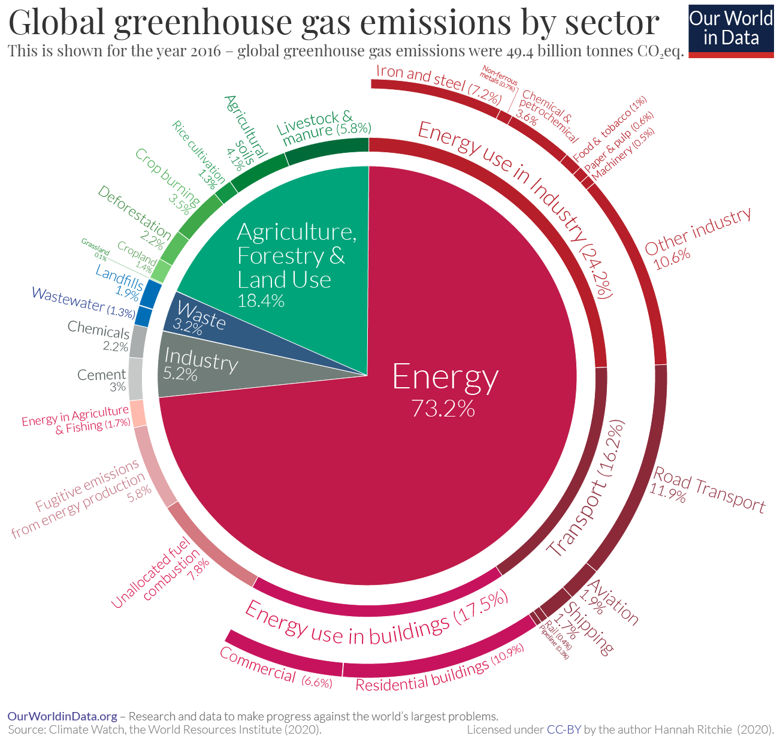

Slide 8
Source: IPCC

Slide 9
Climate Change Amplifies Risks
UNDRR and GIZ

Slide 10
A Comprehensive Approach for Risk Assessment and Planning
Strengthening risk communication, information and knowledge sources
Putting risk to human and ecologic systems at the centre
Fully accounting for the context of climate change
Using iterative and flexible processes
Fully accounting for the context of climate change
Applying inclusive risk governance
Using multi-disciplinary approaches
Notes:
Putting risk to human and ecologic systems at the centre by considering
the dynamic interaction between hazards, vulnerability, exposure, and underlying risk drivers when assessing risk and seeking solutions (risk reduction, adaptation),
comprehensive risk assessments as a foundation and integral part of the overall risk management process,
a common understanding of the broader risk perspective and of the value-added of bringing closer together DRR and CCA community of practice, including a mind shift towards prevention and preparedness,
risk as a value-based concept
Fully accounting for the context of climate change by considering
climate change as an underlying risk driver that modifies climate-related hazards, and partly also vulnerability, and exposure, today and in the future,
the full spectrum of climate-related hazards (extreme events, slow-onset processes and trends) as well as their interaction with non-climatic hazards,
current climate risk as well as future climate risk, insofar as they are relevant to their respective sectors and systems and the decision making and planning process to ensure adaptive planning and dealing with different timescales.
Recognising complex and systemic nature of risks by considering
effects of multiple hazards, compound events, cascading hazards, impacts and risks, as well as linkages between risks across sectors with the objective of understanding how these cascades could be interrupted by risk-reduction measures,
risks to a wide range of interrelated human and ecological sub-systems (including ecosystems and other natural systems, physical assets, humans and livelihoods, societal sectors),
the ‘non-quantifiability’ and high uncertainty in understanding important parts of complex risks which require the application of hybrid, qualitative and participative methods for risk assessment and flexible approaches for risk management towards more resilient systems.
Applying inclusive risk governance by considering
To be inclusive by engaging and partnering with multiple stakeholders, adopting a whole-of-society and whole-of-government approach (public, private, communities, knowledge centres, media, etc.), and strengthening the involvement of decision-makers and populations at risk in order to increase buy-in and facilitate implementation.
Using multidisciplinary approaches to identify and select measures by considering
a wider portfolio and combination of risk reduction and risk management measures (DRR, CCA, etc.), engaging various sectors and systems, to address multiple and context-specific risks,
diverse information and knowledge sources by including at risk population.
Using the concept of risk tolerance to
evaluate risks according to their tolerability to spur action,
inform the identification and selection of appropriate risk reduction and risk management measures
Addressing, minimising, and averting risks through nature-based solutions by considering
the role of ecosystems and their services: as part of the risk (climate impacts on ecosystem and their services cause risks for human systems, degradation of ecosystem services increases vulnerability to climate risks),
the approach to be adaptable to different spatial scales, including transboundary as part of the solution,
Integrating risk across sectors and levels by considering
synergies and trade-offs across multiple levels, linking local realities with national and international processes,
a wider range of planning instruments, ‘game changers’ such as financial instruments and their timing
Strengthening risk communication, information, and knowledge sources by considering
a combination of diverse information sources, methods and knowledge to include scientific, traditional, local and indigenous knowledge, facilitating knowledge co-creation processes and designing measures,
gaps in and needs for climate information and services and strengthening them,
to keep the end-users in mind throughout the assessment and integration process, tailoring risk information.
The potential of behaviour change and individual responsibility.
Using iterative and flexible processes
considering adaptive management and planning based on robust Monitoring, Evaluation and Learning (MEL) frameworks, feeding into an iterative and dynamic process to allow adjustments to planning and implementation,
finally considering the value-added of the overall process itself as a way to help fill capacity gaps, improve information sharing and coordination mechanisms.

Slide 12
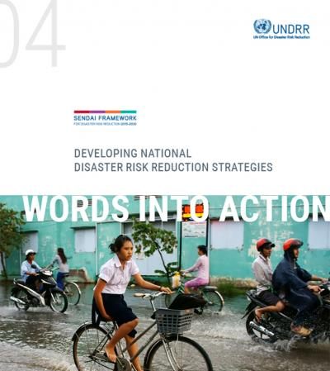
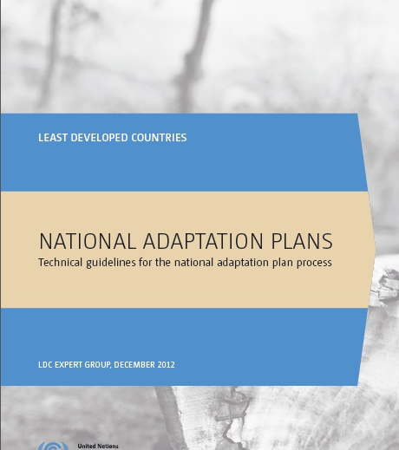
Integration into Planning Processes

Slide 13
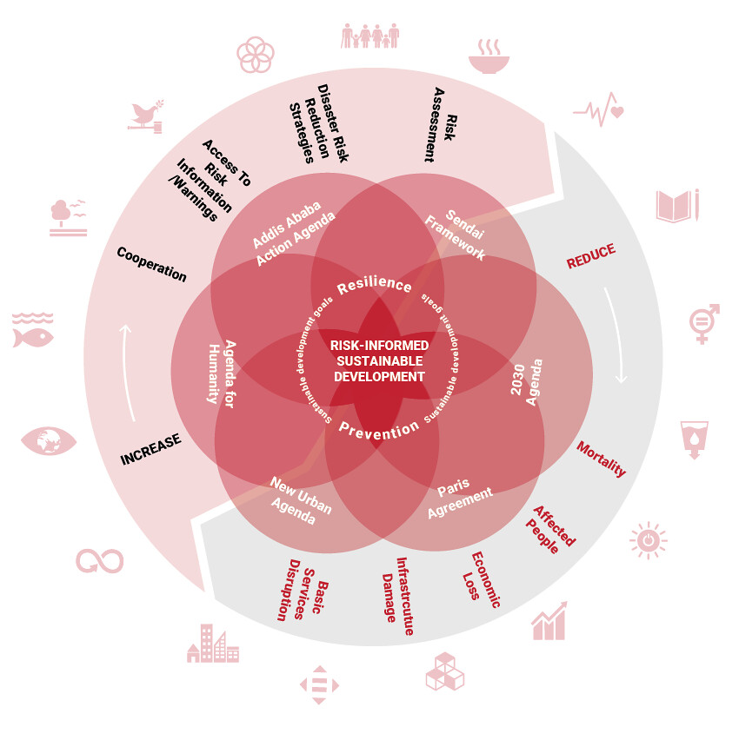
Risk-informed Sustainable Development: Integrated Risk Governance
The Global Assessment Report on Disaster Risk Reduction (GAR), 2019
Notes:
[Facilitator's note: This should come following an introduction to the Sendai Framework and its innovations – emphasizing a shift from disaster management to disaster RISK management.]
The Sendai Framework for Disaster Risk Reduction, the Climate Agreement and Agenda 2030 Sustainable Development Goals have already recognized and embraced a disaster RISK MANAGEMENT approach:
Recognizing the complexity of risk, and its interconnectedness across systems, an INTEGRATED RISK GOVERNMANCE APPRROACH – moving from MUTLIDISCIPLINARY to INTERDICIPLINARY approaches (GAR19)
The focus has to move from managing disasters and threats (protecting old development paradigm against external threats) to managing risks inside development.
Disaster risk and climate change are both dependent variables of development. Therefore risk management cuts across and aligns all three DRR, Sustainable Development and Climate Change frameworks.
Risk management now has to become not an add-on that needs to be mainstreamed into development but a set of practices embedded in its very DNA.
Three approaches to DRM: preventing and avoiding NEW risk, reducing EXISTING risks, and strengthening social and economic resilience need to be combined in appropriate strategies.
(From original Andrew Maskrey, GAR 2015 presentation)

Slide 14
CRM Initiative: A UNDRR Programme to Support Member States
Global Engagements and Partnerships
Guidance and Technical Resources
Research and Analysis
National Technical / Advisory Support
UNFCCC Processes
UN Agencies
Global Networks
Technical Guides
Training Package
Targeted capacity building
Policy landscape
National data
GRAF
Disaster Loss Database
SFM
Technical Papers
Capacity development
In-country support in using CRA and Planning in NAPS and DRR Strategies
Resilient Transformative Sustainable

Slide 15

Thank you

